Slide 1

Review: Paper Reading
Mining and Summarizing Customer Reviews
范老师
2020/04/16

Slide 2
Content
Background
Related Work
Problem Definition
System Design
Experiment
Conclusion
Reference

Slide 3
Background
Countless customer reviews
Potential customer:
View the reviews before purchasing
Product manufacturer:
Keep track of customer opinions

Slide 4
Related Work
Subjective genre classification
No opinion orientation
Classification is not done at sentence level
2. Sentiment classification
Should be define a lexicon manually, which is usually domain-dependent
Classification is not done at sentence level
No feature-extraction
Text summarization
Template instantiation: not domain-independent
Passage extraction: only identify sentences rather than product features and opinions
Terminology finding
Symbolic approaches: the discovered noun phrases leads to low precision
Statistical approaches: miss many low frequency terms

Slide 5
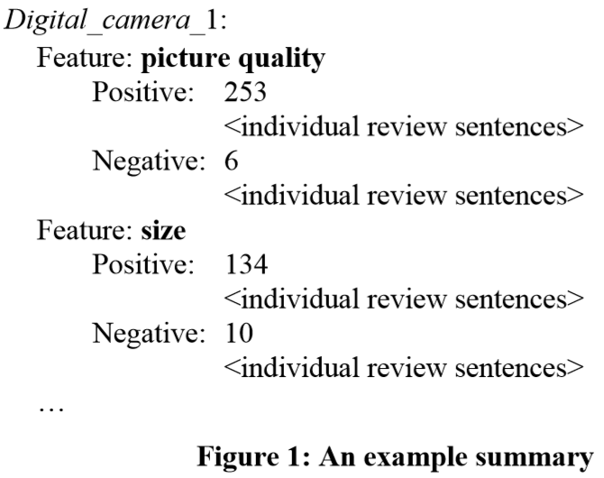
Problem Definition
Generate feature-based summaries of customer reviews of products sold online.[1]
Identifying features of the product that customers have expressed their opinions on [1]
For each feature, identifying review sentences that give positive or negative opinions [1]
Producing a summary using the discovered information [1]

Slide 6
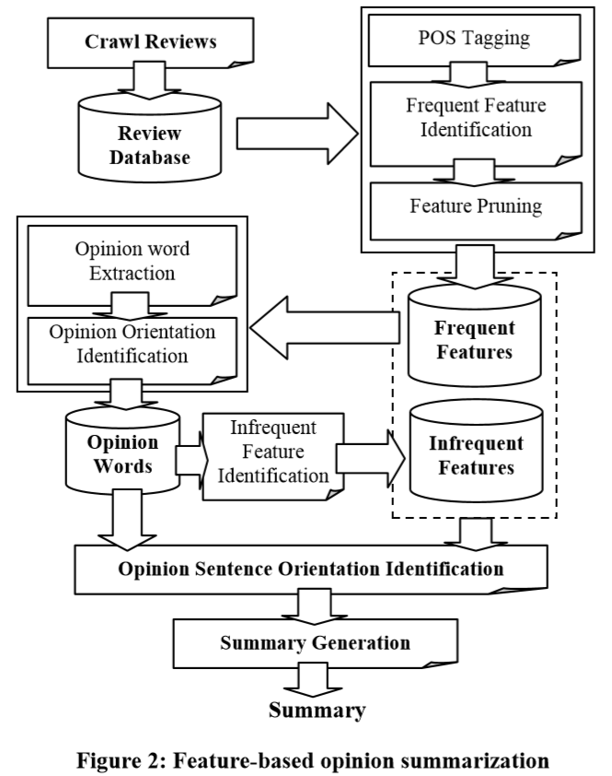
System Design

Slide 7
System Design
Part-of-speech tagging (POS)
Only extract nouns and noun phrases
2. Frequent features identification
Association mining: CBA (based on apriori algorithm)
Compactness pruning: delete features whose words are not in a defined order
Redundancy pruning: if ftr is lower than a threshold, and it is part of a feature phrase. 从语义的个数上，不构成一个相对有意义的属性单元。

Slide 8
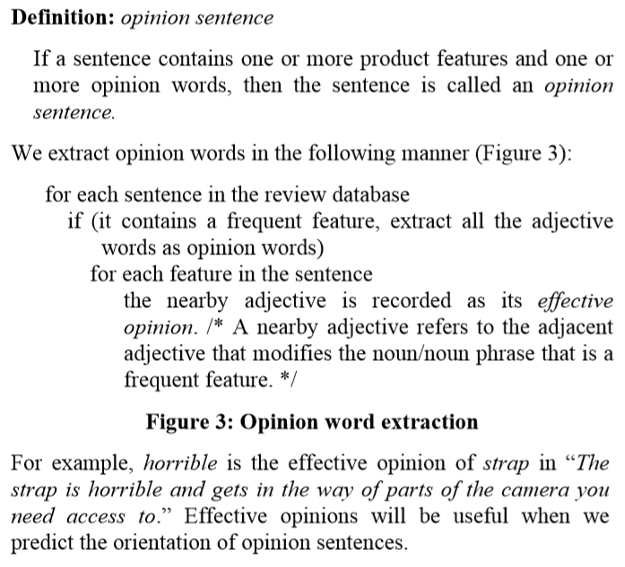
System Design
Opinion words extraction
Only extract adjective

Slide 9
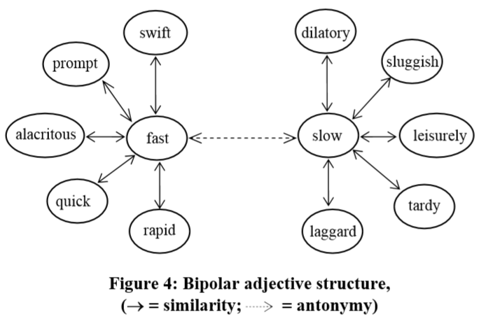
System Design
4. Orientation identification for opinion words
Related works relying on statistical information is inefficient, for it requires search engine.

Slide 10
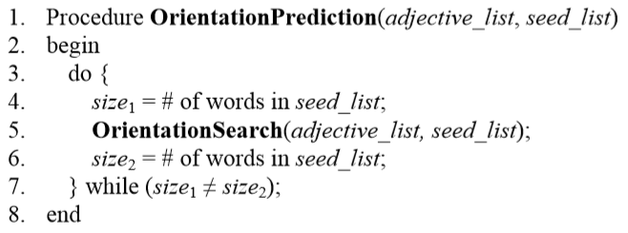
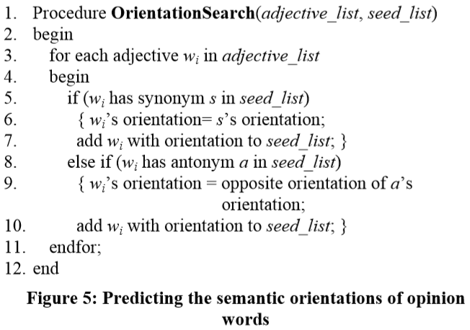
System Design
Orientation identification for opinion words
A set of seed adjective words is required

Slide 11
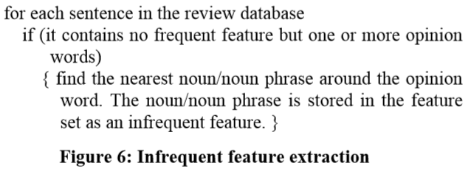
System Design
5. Infrequent feature identification
Use nearest rule to discover infrequent feature based on known opinion words

Slide 12
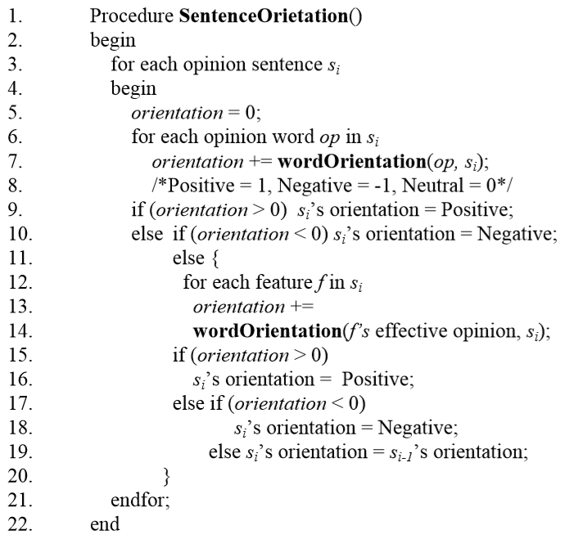
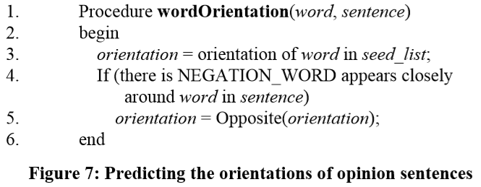
System Design
6. Predicting the orientations of opinion sentences

Slide 13
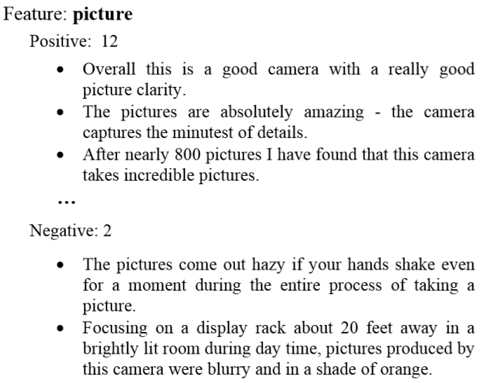
System Design
7. Summarization generation

Slide 14
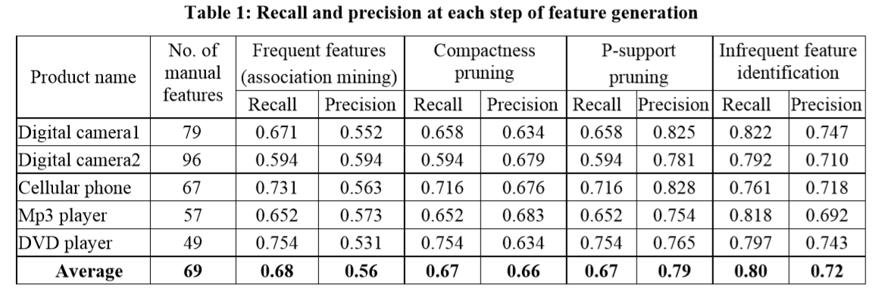
Experiment
Dataset: 5 products and manually tag all features
Evaluation: feature extraction, sentence extraction and accuracy of orientation prediction
Table 1 and 2 proves the effectiveness of feature generation

Slide 15
Conclusion and Future Work
Data mining + NLP to get opinions on product features
Future work:
Pronoun resolution
Strength of opinions
Opinions expressed in adverbs, verbs and nouns
Tracking customer’s new reviews

Slide 16
Reference
[1] M. Hu, B. Liu: Mining and summarizing customer reviews. KDD 2004: 168-177

Slide 17
Thanks!

